Slide 1
EE 4130 Systems Engineering Test - IV&V/Chapter 6
Prof Joel Harris
18 April 2018
CSULA – ECST Department

Slide 2
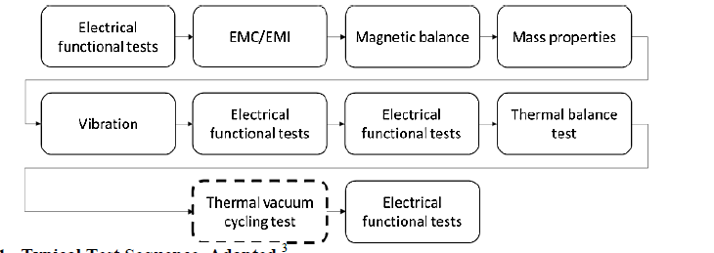
Boilerplate test flow chart

Slide 3
Testing progression Flowchart

Slide 4
Test level decision matrix

Slide 5
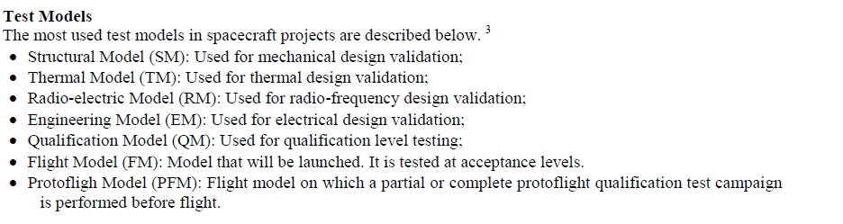
“Flavors”/fidelities of test hardware

Slide 6
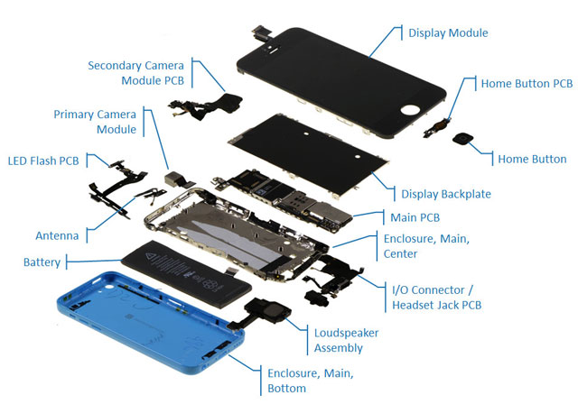
Example: smartphone subassemblies

Slide 7
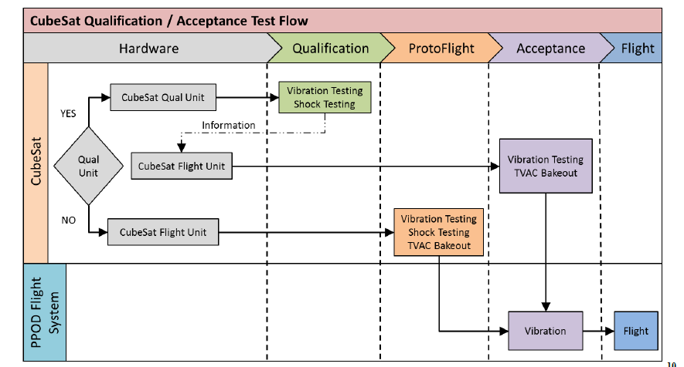
An Example of space hardware test flow

Slide 8
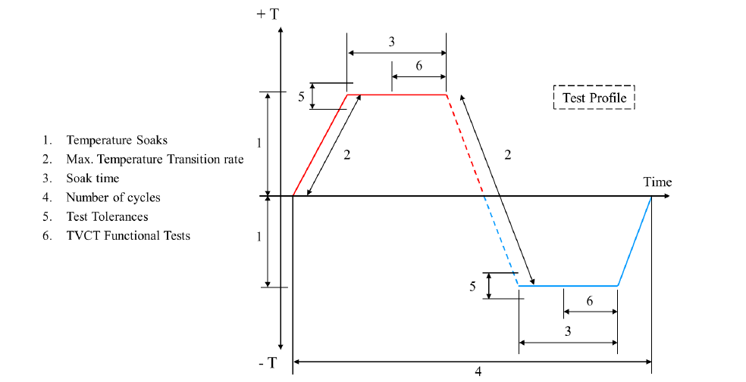
Thermal vacuum testing profile sample

Slide 9
Qualification vs. acceptance testing
“Qualification” is the formal proof that the design meets all requirements of the specification and the parameters agreed in the Interface Control Documents (ICD) including tolerances due to manufacturing imperfections, wear-out within specified life-time, faults etc.
“Acceptance” is the formal proof that the product identified by its serial number meets all requirements of the specification and is free of workmanship and material failures. Acceptance is based on the preceding qualification by reference to the used design / manufacturing documentation.

Slide 10
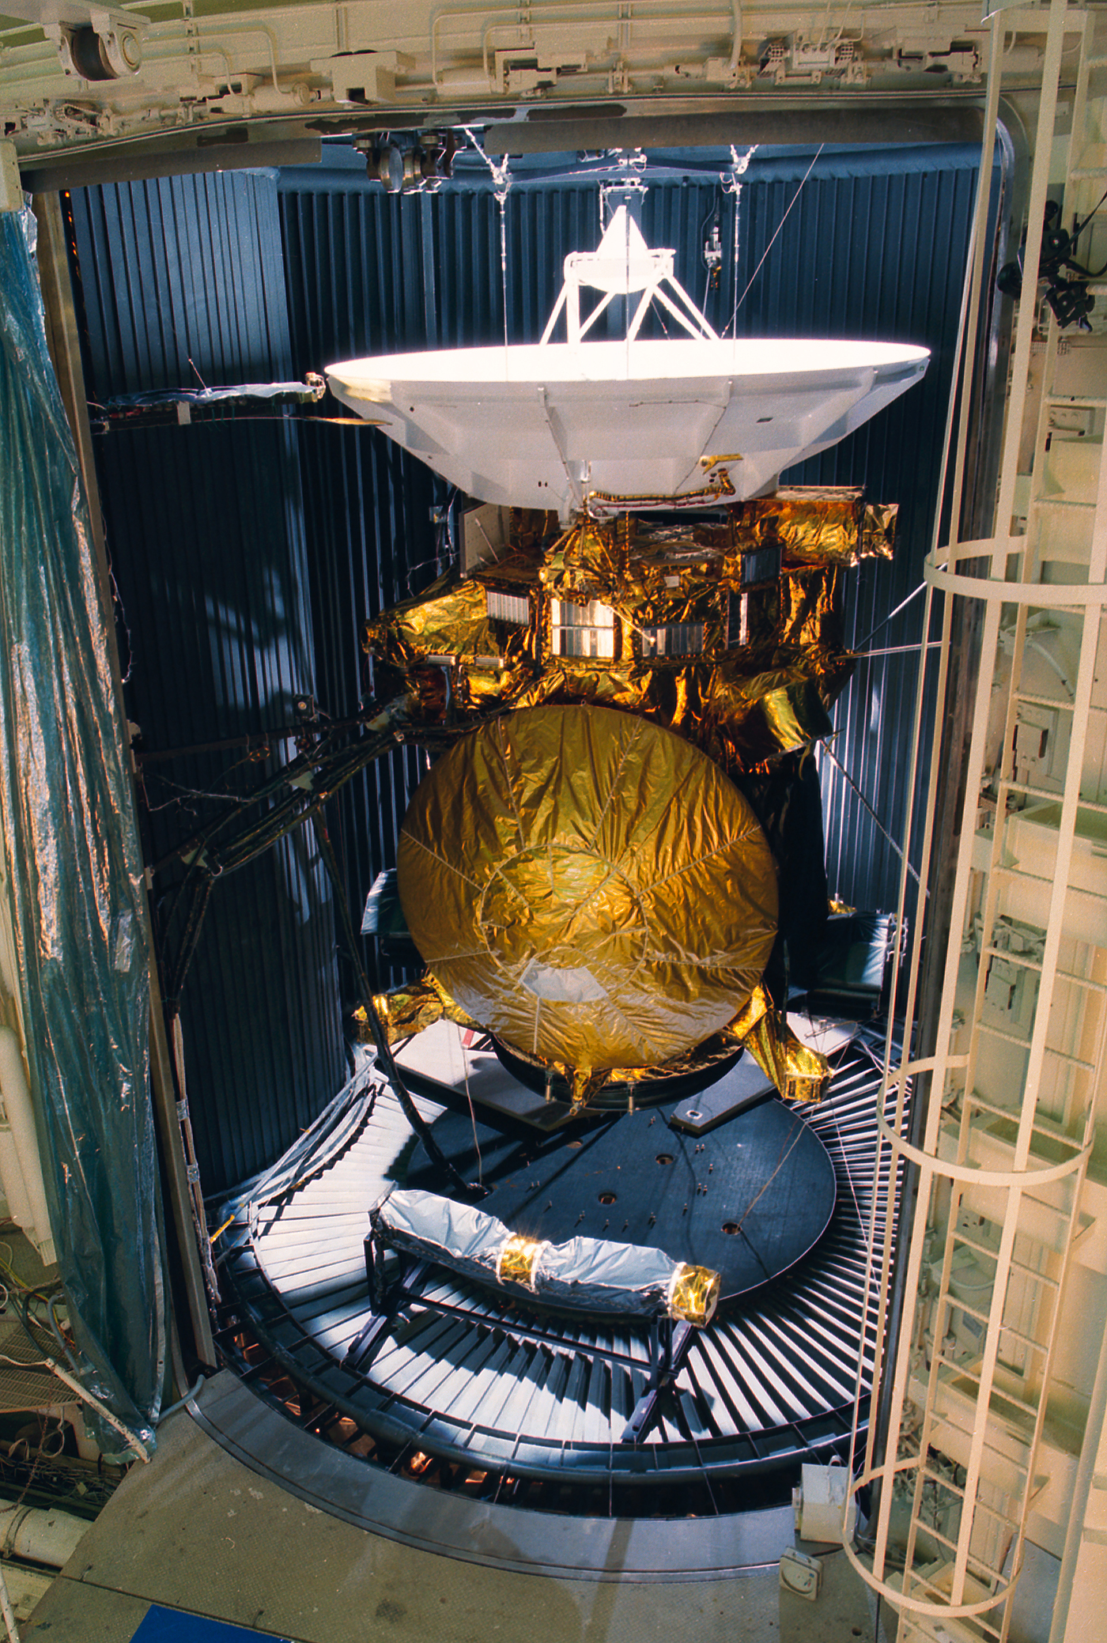
STV Chamber image
© NASA/Jet Propulsion Laboratory

Slide 11
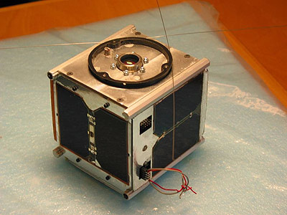
AAU Cubesat image
10 cm

Slide 12
Sample TVC Test Procedure (cubesat)
Test procedure:
Verify that the satellite is turned off
Depressurize chamber
When pressure drops below 0.01 Torr then turn on satellite (Corona Effect) and perform functional test
Upload flight-plan to issue system wide GetStatus commands every two minutes
The temperature of the controlled plate is increased to 85 degrees (Celsius)
The temperature remains at 85° for until all temperature sensors are within 33% of the target temperature
The temperature of the controlled plate is decreased to -30°
The temperature remains at -30° until all temperature sensors are within 33% of the target temperature
The temperature is increased to 20° degrees
The temperature remains at 20° until all temperature sensors are within 33% of the target temperature
Satellite is turned off
Chamber is pressurized. Test completed.

Slide 13
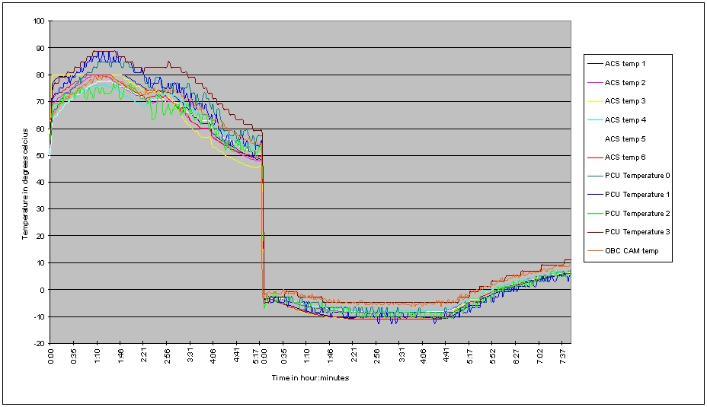
Thermal test data graph

Slide 14
Conducted vs. radiated emi/EMC
Conducted Emissions
Conducted emissions are electromagnetic energy created by a device and transmitted in the form of an electrical current through its power cord. This can potentially cause problems since power cords are connected to the entire power distribution network.
Radiated Emissions
Radiated emissions are electromagnetic energy created by a device and released as electromagnetic fields that propagate through air, away from the device. Electric devices that create radiated emissions have the potential to interfere with other nearby electrical products.

Slide 15
Common EMI/EMC Test types
Conducted Emissions (CE 101, 102, 106)
Conducted Susceptibility (CS 101, 103, 104, 105, 106, 109, 114, 115, 116)
Radiated Emissions (RE 101, 102, 103)
Radiated Susceptibility (RS 101, 103, 105)
Electrostatic Discharge (ESD)

Slide 16
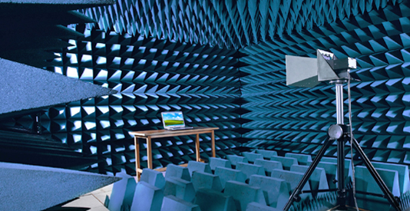
EMI/EMC Test Facility/Anechoic Chamber

